Slide 1
Jefferson v.
Hamilton
Who said it?

Slide 2
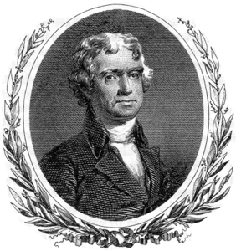
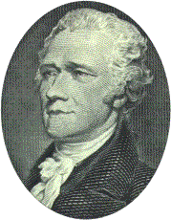
Who said it?
“All communities divide themselves into the few and the many. The first are the rich and well born; the other, the mass of people . . . The people are turbulent and changing; they seldom judge or determine right. Give therefore to the first class a . . .permanent share in the government . . . They therefore will ever maintain good government.”

Slide 3
Nope, it wasn’t Jefferson. Try again. Remember—he’s on the side of common people.

Slide 4
Yep! Of course it was Hamilton. He felt the elite should be the ones making the decisions.

Slide 5
Who said it?
“Our country is too large to have all affairs directed by a single government.”

Slide 6
Great! You realized that Jefferson thought the power should be given to the states! Good deduction!

Slide 7
Well, you really ought to know that Hamilton wanted a strong federal government. He’d probably never have made this statement.

Slide 8
Who said it?
“The small landowners are the most precious part of the state.”

Slide 9
You’re right. It was Jefferson. He envisioned an economy based on small, independent farmers.

Slide 10
Hamilton? No way. He wanted industry to rule the country. Oops!

Slide 11
Who said it?
“It must be by this time evident to all men . . that {the Articles of Confederation} is a system so radically vicious and unsound as to admit . . . an entire change.”

Slide 12
Jefferson? No way. He liked the Articles of Confederation because it favored the states. Try again.

Slide 13
Hamilton? But, of course. Fantastic deduction! He favored the power of the federal government. The Articles of Confederation made for a weak federal government. Therefore, it makes sense that he saw this document as vicious and unsound. Bravo!

Slide 14
Who said it?
“The superiority
. . . enjoyed by nations that have
. . . perfected a branch of industry constitutes a
. . . formidable obstacle.”

Slide 15
Jefferson? You are mistaken. Remember a few slides ago how we said Jefferson liked the idea of small, independent farmers? Go back and reread the quote.

Slide 16
Hamilton is obviously the best answer. You accurately pinpointed the fact that Hamilton was the one who favored industry as a way to make our country superior. Way to go!

Slide 17
Who said it?
“I consider the foundation of the Constitution as laid on this ground—that all powers not delegate {given} to the United States by the Constitution , nor prohibited by it to the states, are reserved to the states, or to the people . . .”

Slide 18
Jefferson? TJ was a “power to the people” kind of guy. Glad you’ve chosen wisely. ☺

Slide 19
Hamilton? Close, but no cigar. The only way Hamilton would give power to the people was if they were the elite (rich and powerful). He felt safest when the federal government held most the power.

Slide 20
Who said it?
“The powers contained in a constitution . . . ought to be construed liberally in advancement of the public good.”

Slide 21
Jefferson? Absolutely not! He wanted leaders to interpret the Constitution with a strict construction. He felt we were bound to follow the Constitution the way it was written, word for word. Go back and read it more closely this time!

Slide 22
Hamilton? You hit the nail on the head with this one! He believed in loose, or broad construction of the Constitution. That way, leaders could interpret the document the way they saw fit.

Slide 23
Who said it?
“I am not among those who fear the people. They, not the rich, are our dependence for continued freedom.”

Slide 24
It’s Jefferson again! Like we discovered earlier, TJ was a “power to the people” kind of guy. This would obviously only have been said by him. Perfect selection!

Slide 25
Sadly, you are mistaken. Hamilton kind of did fear people. (At least those who weren’t elite people.) He definitely did not see the common person as the tool to preserve continued freedom.

Slide 26
So, how’d you do?
Hopefully you scored a 100. But, if you didn’t, be sure you understand why you missed the ones you did.
Great work!

Slide 27
Citations
www.bartleby.com/124/ jefferson.gif
www.currencygallery.org/vignettes/hamilton.gif

